Slide 1


Name of Project: Energy Consumption Trend Analysis with Power BI
Name:Riya Thakur
Internship ID :
INTERNSHIP_174099535967c57b1f336c3

Slide 2

Learning Objectives
The objective of this project is to help us(Students) to learn how to use Power BI to analyze and visualize Energy Consumption data.
This this project, We were will be able to:
1.Collect and input the Energy usage data
2.Create visual reports and dashboards in Power BI
3.Identify patterns and trends.
4.Generate insights to help reduce energy waste and
improve efficiency
GOAL
Source :
www.freepik.com/

Slide 3
Tools and Technology used
1.Power BI
Purpose= to Visualized the Data and Create Interactive Dashboard
Features used in this Project= Textbox,Button,Piechart,Cards,Line chart,Button
slicer,Waterfall chart
2.Microsoft Excel/CSV File
Purpose=Storing and Organzing Raw Energy Consumption of the Data
Features used in this Project=Excel Sheet Data
3. Cloud Storage / Online Sources (Optional)
Examples= SharePoint, OneDrive
Use= Accessing real-time or regularly updated energy data

Slide 4
Methodology
In this Methodology we Analyze energy consumption trends and create visual insights using Power BI.
First we Gather Data of Energy Consumption from relevant sources and input their data in Excel/CSV files
Using Power Query in Power BI to Remove duplicates and Missing value, Filter out irrelevant data and Create calculated columns (e.g., Sum/Year/Average Consumption)
Design interactive visual dashboards in Power BI that include Line and bar charts for trend analysis, Pie charts or donut charts for category-wise usage, Time slicers for filtering by date ranges
Preparing a project report of the presentation that includes Overview of findings, Screenshots of Power BI dashboards
Share findings with mentors or stakeholders

Slide 5
Problem Statement:
Organizations often collect energy consumption data in large set, but they lack the tools and methods to analyze this data effectively.
As a result, identifying patterns, detecting inefficiencies, and making informed decisions becomes difficult. Without clear visualization and trend analysis, energy usage remains unmanaged, leading to unnecessary costs and missed opportunities for optimization.
This project addresses the need for a data-driven approach by using Power BI to analyze, visualize, and monitor energy consumption trends, enabling better energy management and strategic planning.

Slide 6
Solution:
To address the lack of visibility and insight into energy usage, this project proposes the use of Power BI as a powerful business intelligence tool to analyze and visualize energy consumption data.
The solution involves collecting raw energy usage data, cleaning and preparing it using Power Query, and performing time-based analysis using DAX.
By creating interactive dashboards and visual reports, the project enables users to monitor energy trends, identify peak usage periods, detect anomalies, and uncover inefficiencies. These insights help organizations make data-driven decisions to reduce energy waste, lower operational costs, and improve sustainability efforts.

Slide 7
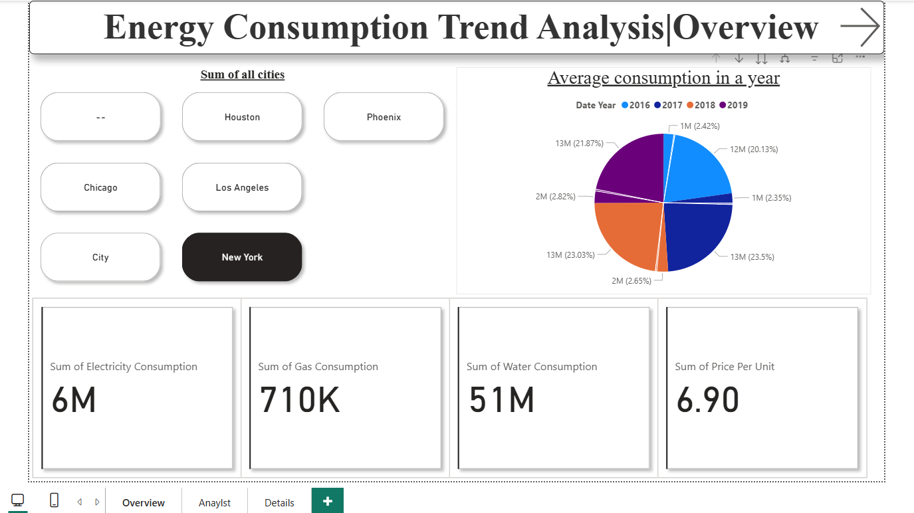
Screenshot of Output:

Slide 8
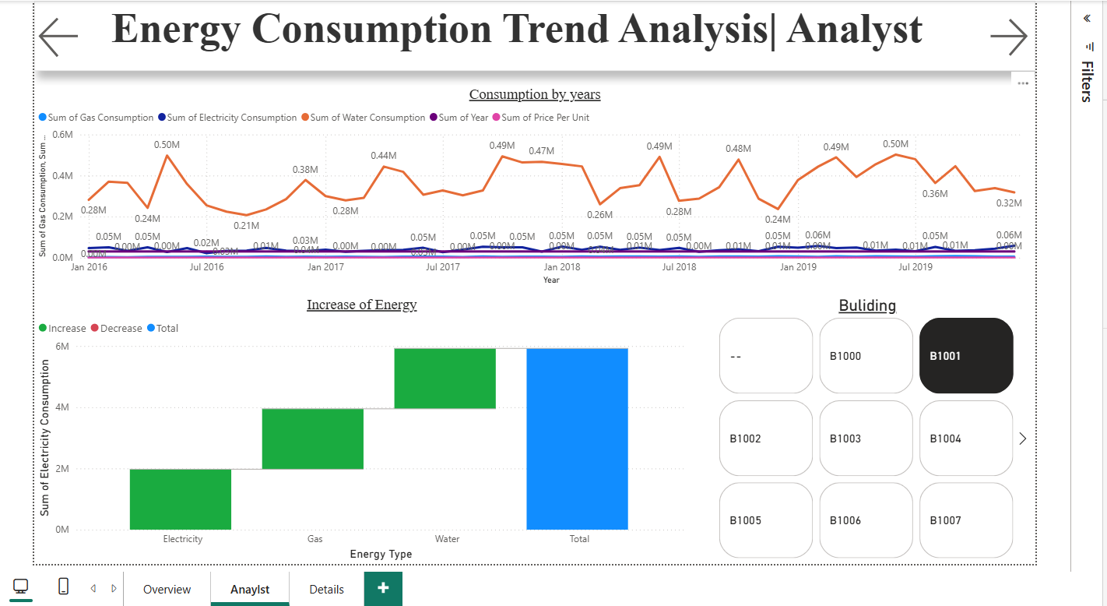

Slide 9
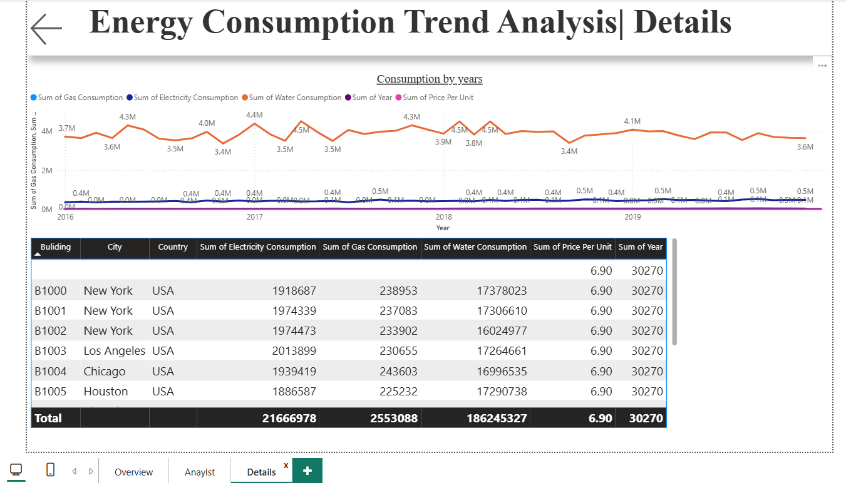

Slide 10
Conclusion:
This internship topic Energy Consumption Trend Analysis with Power BI project is successfully demonstrates on how data visualization and intelligence tools can transform raw energy usage data into meaningful insights.
By leveraging Power BI’s application capabilities such as data modeling, interactive dashboards, and real-time analytics this project enables organizations to better understand their energy consumption patterns. The analysis helps in detecting unusual spikes, and uncovering inefficiencies that would otherwise go unnoticed in traditional reporting formats.
We can implement more effective energy-saving strategies, reduce operational costs, and contribute to sustainability goals. this project highlights the importance of data-driven decision-making in energy management and showcases how modern tools like Power BI and other data visualization tools can play a crucial role in optimizing resource usage.

